Slide 1


Network Security Design and Automated Wi-Fi Testing
Course: Network Security
https://github.com/lmolinario/Network_Security_Project.git
Authors:
Lello Molinario, Federico Moro
Advisor:
Prof. Marco Martalò

Slide 2
Introduction
This presentation explores the design and implementation of an automated Wi-Fi network testing system. We examine security protocols, hardware components, and key techniques for vulnerability assessment.
The system aims to streamline network penetration testing whilst providing valuable insights for both smart agriculture and forensic applications.

Slide 3
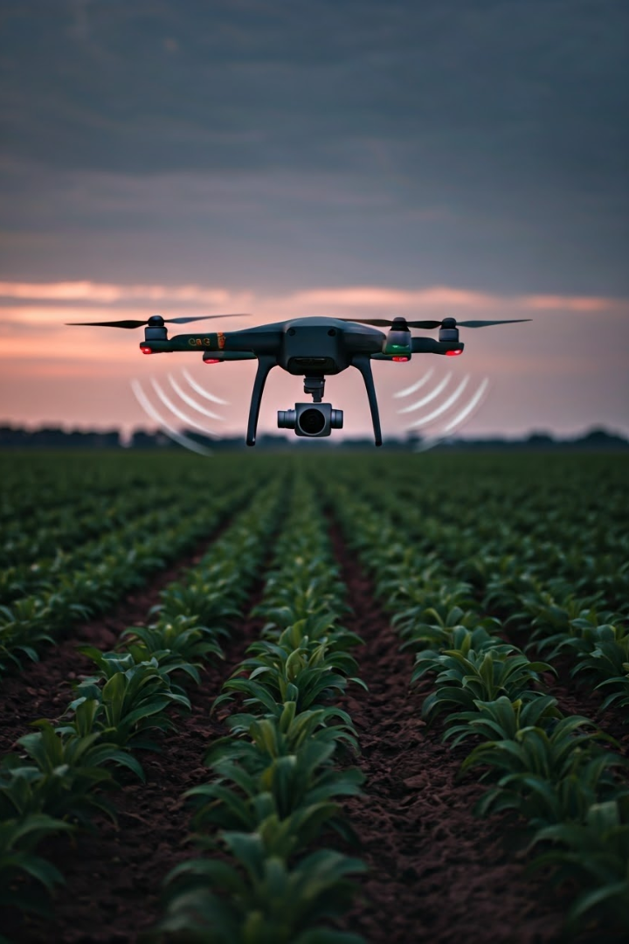
Applications in Smart Agriculture
Crop Monitoring
Secure connectivity for sensors measuring soil moisture, nutrient levels
and plant health.
Equipment Management
Tracking and controlling automated farming machinery through robust
wireless networks.
Data Collection
Ensuring integrity of agricultural data transmitted from field sensors
to central systems.

Slide 4
Smart Agriculture and LPWAN Technologies
LoRa Technology
LoRaWAN
IEEE 802.15.4
Long-range wireless protocol enabling low-power, long-distance communication for IoT devices in agriculture.
Network architecture built on LoRa, providing secure bi-directional communication for smart farming applications.
Standard for low-rate wireless networks, forming the basis for ZigBee and other agricultural IoT protocols.

Slide 5
The ’Forensic’ Area
The potential use of Wi-PY in Forensic Investigation is noteworthy. With the introduction of Law No. 3 of 9 January 2019, the so-called "anti-corruption" law, new measures were established to tackle corruption and strengthen the fight against crimes in public administration.
This allows to a potential use of Wi-PY for automating vulnerability scanning processes within a wireless network, allowing for the insertion of an exploit or targeted attacks on individual devices.

Slide 6

Wi-Fi Security Protocols
1
WEP
Outdated protocol using static keys. Easily cracked due to vulnerabilities in RC4 implementation.
2
WPA/WPA2
Improved security with TKIP and AES encryption. WPA2 is current standard for most networks.
3
WPA3
Latest protocol offering enhanced protection against password guessing and stronger encryption for public networks.

Slide 7
Objectives of the project
1
Hardware Analysis
2
Python Development
3
Vulnerability Discovery
4
Data Export
5
Result Analysis

Slide 8

Hardware Components
Raspberry Pi 3 B+
Core computing unit providing processing power and GPIO connectivity for the testing system.
GPS Module
U-Blox USB GPS module for precise geolocation of tested networks.
Alfa AWUS036NEH
High-power USB Wi-Fi adapter supporting monitor mode for packet capture and injection.
Notes:
Thanks Federico.
Now let's explain the hardware components we used:
A Raspberry Pi 3 B+ that provides processing power and connectivity for the test system.
A GPS module for geolocalizing the tested networks.
a small aside: we thought that this module would also be useful for future implementations:
In fact, if the system could been mounted on an unmanned vehicle, once it reached the chosen coordinates it could have started the tests automatically.
Finally, a USB Wi-Fi adapter that supports monitor mode for packet capturing and injection

Slide 9

Software Tools & Techniques
1
Aircrack-ng Suite
Comprehensive set of tools for assessing Wi-Fi network security, including WEP/WPA key cracking.
2
Besside-ng
Automated tool for capturing WPA handshakes and cracking WEP keys on multiple networks simultaneously.
3
Nmap
Powerful network scanner used for port discovery and vulnerability assessment of target networks.
4
Custom Python Scripts
Developed to automate the testing process, coordinate hardware components, and manage data collection.
Notes:
I want to make a small premise: the python script we developed was written completely without any help from artificial intelligence.
I apologize if there are imperfections or redundancies in the code, but we believe that human creative activity is an added value and these imperfections underline it.
We have preserved the modularity of the code by developing different "Classes" for each single action that the program must undertake.
Using system calls and global variables we were able to acquire the information necessary to test the wifi networks we prepared.
To do this we used tools at our disposal such as Aircrack, Besside and Nmap.
In this last case I would like to say that we decided to use the nmap command for several reasons: the most important is the possibility of using specific scripts.
In particular Nmap Scripting Engine (NSE) which is one of the most powerful and flexible features of Nmap that allows to manage even the most demanding vulnerability checks.

Slide 10

System Operation
1
Network Detection
System scans for nearby Wi-Fi networks, identifying SSID, encryption type, and signal strength.
2
Packet Capture
Targeted networks are analysed using tools like besside-ng to capture authentication handshakes.
3
Password Cracking
Captured handshakes are processed with aircrack-ng to attempt password recovery using dictionaries.
4
Vulnerability Scanning
Nmap is utilised to identify potential security weaknesses in successfully accessed networks.
Notes:
Now let's explain step by step what the developed code does:
after starting it, the coordinates are read and the Google Maps URL is generated.
After that, existing networks are scanned and useful packets are captured.
This reading is done via 'besside-ng' which will generate a log file and two *.cap files (one file for WEP networks and one file for WPA networks).
When a useful 'handshake' is detected or enough network packets are captured, aircrack-ng is immediately started.
These operations are performed for all found testing networks and continue until it finds the appropriate password for the network.
In our case there are networks that we are not interested in (since they are outside our test area), so the system refuses the scan.
Once this first phase is completed, it performs the vulnerability scan via nmap.
To do this, the program automatically connects to the previously scanned networks and starts looking for vulnerabilities in the network access point and its clients.
Once this process is completed, all the acquired information is transferred into a specific .csv file.

Slide 11

Data Analysis & Reporting
Security
Protocol
Password Recovered
Vulnerabilities Found
Network SSID
SOSSU
WPA2
Yes
2
MyASUS
Open
Yes
5
*= No clients connected
TP-LINK3CE9
WEP
Yes
0*
Notes:
We tested several Wi-Fi networks. They differed in security protocol and encryption.
One called "SOSSU" which uses WPA2 as authentication method.
One called "TP-LINK" which uses WEP as authentication method.
One called "Myasus" which is open.
In all of them passwords were found (obviously where passwords can be found, in our last case MYASUS is an open network)
and also we found several vulnerabilities in their clients: TP-LINK was an exception because no clients was connected.

Slide 12
Ethical & Legal Considerations
Authorised Testing Only
Data Protection
Responsible Disclosure
System should only be used on networks with explicit permission to avoid legal issues.
Strict protocols for handling and storing any captured network data to ensure privacy.
Clear guidelines for reporting vulnerabilities to network owners in a constructive manner.
Notes:
During the tests if the system had no restrictions it could have tried to hack all the networks in its range
and for this reason we made a series of considerations:
First one is that The system should be used only on networks with explicit authorization to avoid legal problems.
In case of acquisition of network vulnerabilities, protocols for the management and storage of all acquired network data must be guaranteed.
And last but not the least, In case we have to do a test for other people there must necessarily be a clear way to report the vulnerabilities to the owners of the network being tested
(in our case we record everything, every data in a csv file)

Slide 13

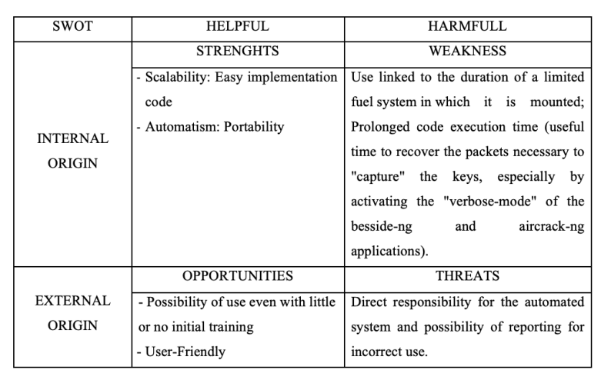
Conclusions
Notes:
So, finally we made some more considerations.
Using this system we noticed strengths and weaknesses.
The strengths are:
System scalability (the system can be implemented with other hardware and features very easily);
Ease of code implementation;
Portability of the system;
The weaknesses are:
Use tied to the duration of a limited power system in which it is mounted;
Extended code execution time (The time needed to "capture" packets is very high if we enable the "verbose mode" in besside-ng and aircrack-ng applications).
Furthermore, using this system we also noticed OPPORTUNITIES and THREATS
OPPORTUNITIES are:
possibility of use even with little or no initial training because all the execution can be automated;
and for this reason it is very User Friendly (it is very easy to use!)
We have thought at only one big THREAT and that is:
the direct responsibility of the user on the automated system and the consequent possibility of being reported to the Authorities for improper use.

Slide 14
Future Developments
AI-Powered Analysis
Incorporating machine learning for more sophisticated vulnerability detection and password cracking.
Extended Protocol Support
Expanding capabilities to test emerging wireless standards like Wi-Fi and 5G networks.
Miniaturisation
Further reducing system size for easier deployment on drones and other mobile platforms.
Continuous Learning
Developing systems to automatically update attack databases based on new security research.
Notes:
Well, we also considered future developments,
such as the possibility of using AI to test networks and extending the capabilities to test emerging wireless standards
(currently in our system, although it was possible, we have not tested other wifi standards such as those used in Smart Agriculture).
We also considered the possibility of reducing the size of the system for easier deployment on drones and other mobile platforms.

Slide 15
Thanks for the attention
Notes:
This presentation is over.
Thank you for your attention.
If you have any questions, we will be happy to answer them.

